Slide 1
海冰动力学文献 SIREx part 2
05.09

Slide 2
Sea Ice Rheology Experiment (SIREx): 2. Evaluating Linear Kinematic Features in High-Resolution Sea Ice Simulations
Nils Hutter, et. al. 2022. JGR Oceans.
Alfred-Wegener-Institute, Helmholtz Zentrum für Polar- und Meeresforschung, Bremerhaven, Germany.
Key points.
All models simulate linear kinematic features (LKFs), but none accurately reproduces all LKF statistics.
Resolved LKFs are affected strongest by spatial and temporal resolution of model grid and atmospheric forcing and rheology.
Accurate scaling of deformation rates is a proxy only for realistic LKF numbers but not for any other LKF static.
Notes:
Journal of Geophysical Research

Slide 3
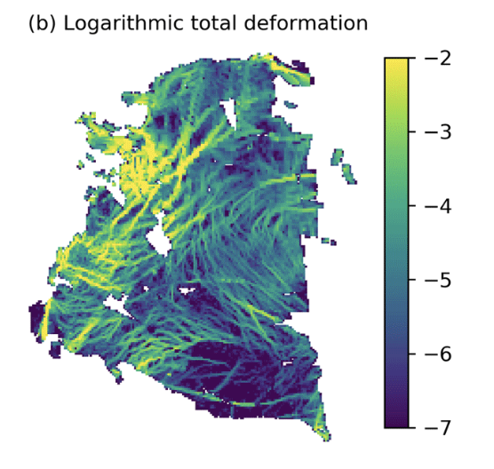
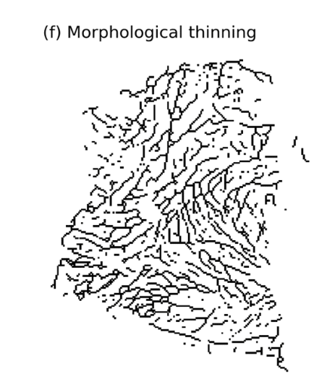
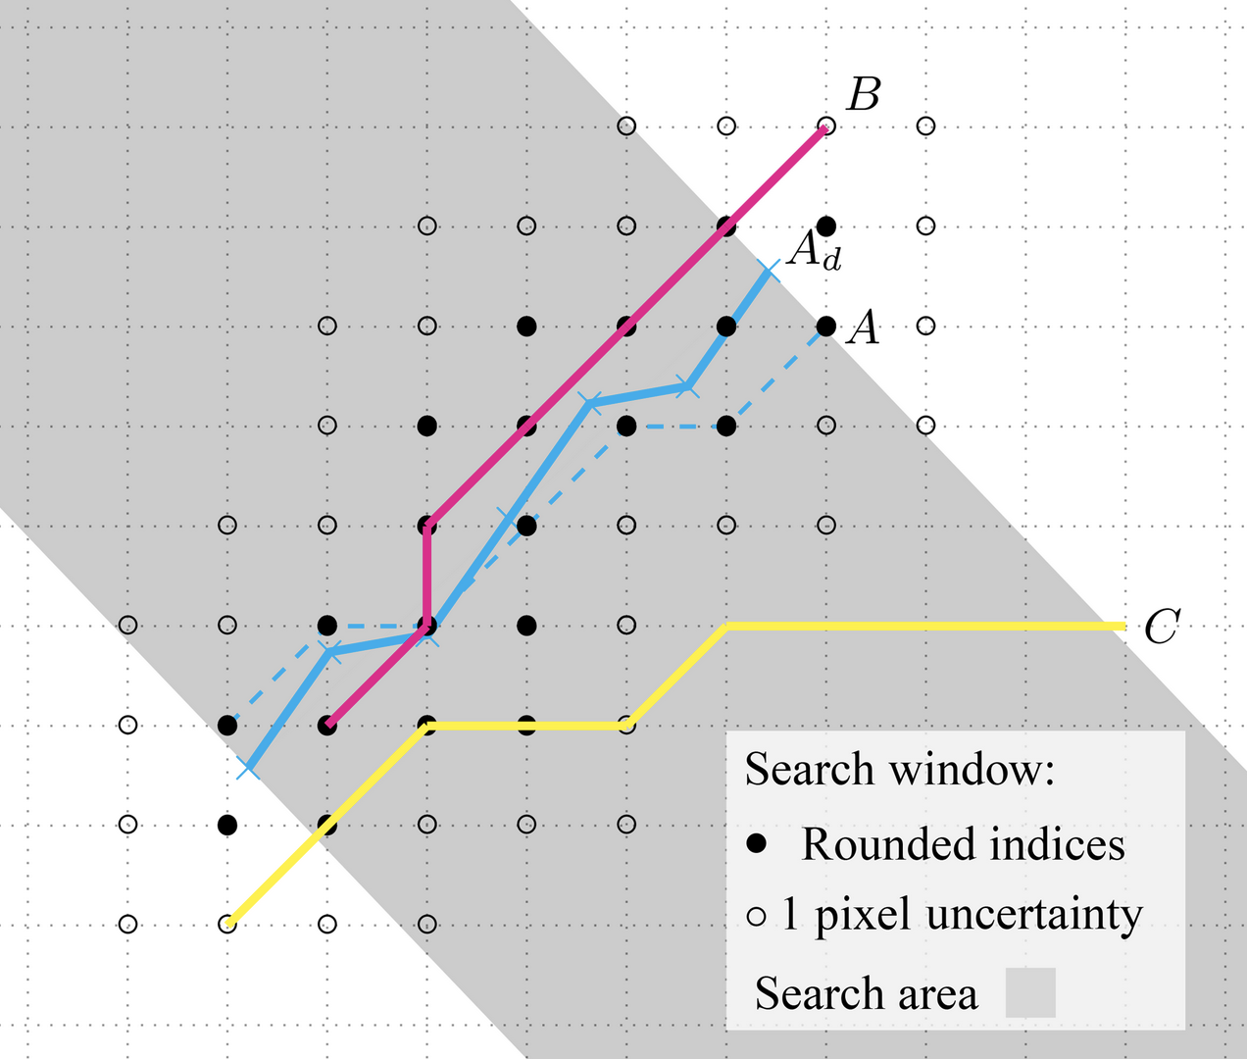
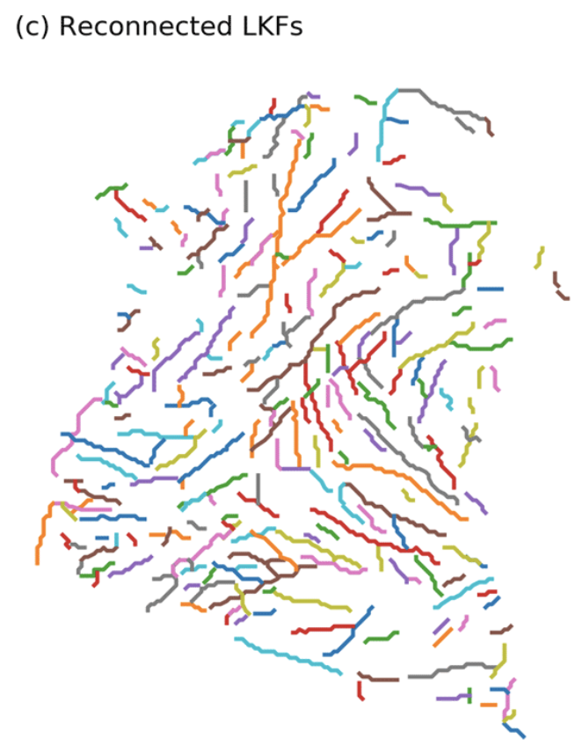
Models and Observations
A total of 22 simulations from 11 different models (daily mean fields or daily snapshots).
From the RGPS deformation data set, an LKF data set was generated that contains 165 000 detected and 36 000 tracked LKFs in the winters (January, February, and March) 1997 to 2008.
Automatic feature detection and tracking (Hutter et al. 2019a).
Notes:
对统计结果影响不大
从原始变形图，创建 LKF 像素的二进制图，其变形率明显高于其直接邻域。 然后，这个二值图被划分为相邻 LKF 像素的短片段。 最后，根据描述它们的距离、相对于彼此的方向以及变形率差异的概率函数重新连接段。
跟踪算法使用后续 LKF 场对之间的漂移信息来平流第一个场的 LKF。 然后将平流特征与第二个字段中的 LKF 进行比较。 基于第一场的平流 LKF 和检测到的第二场的 LKF 之间的重叠程度来识别跟踪的 LKF。
https://tc.copernicus.org/articles/13/627/2019/

Slide 4
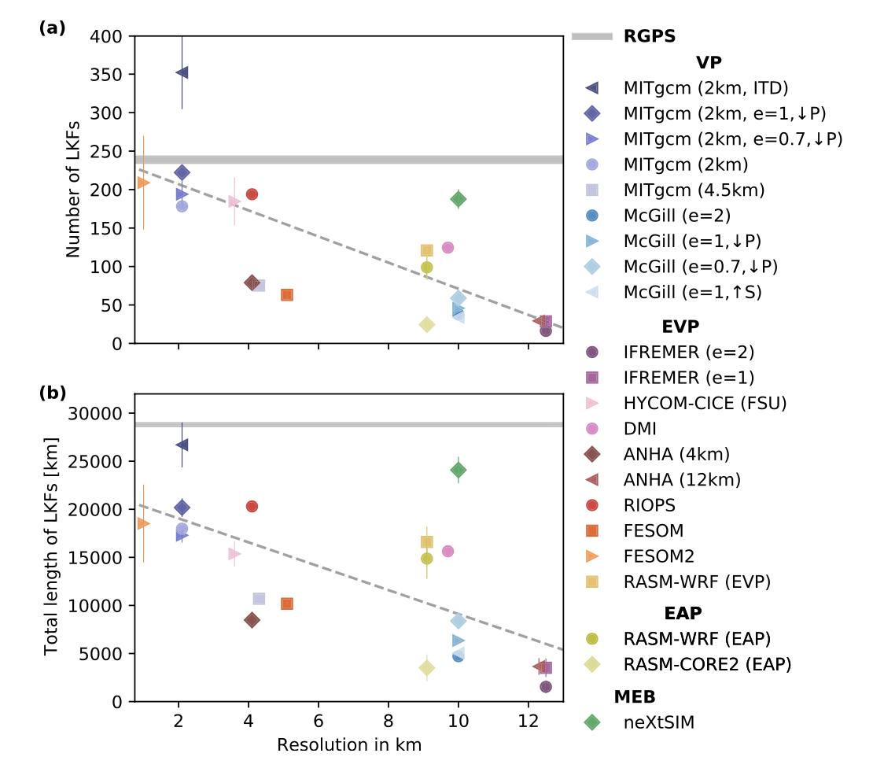
Total length directly related to the total area of potential air-ice-ocean interactions.
Related to resolution for (E)VP.
More ITD classes lead to more resolved LKFs.
Coupling to an interactive atmosphere rather than forcing it with atmospheric reanalysis increases the number (RASM). Or increased EVP subcycles?
Notes:
The interannual variability of the LKF number and length for each model that contributed simulations for 2 years is shown as a thin vertical line around the multiyear mean.

Slide 5
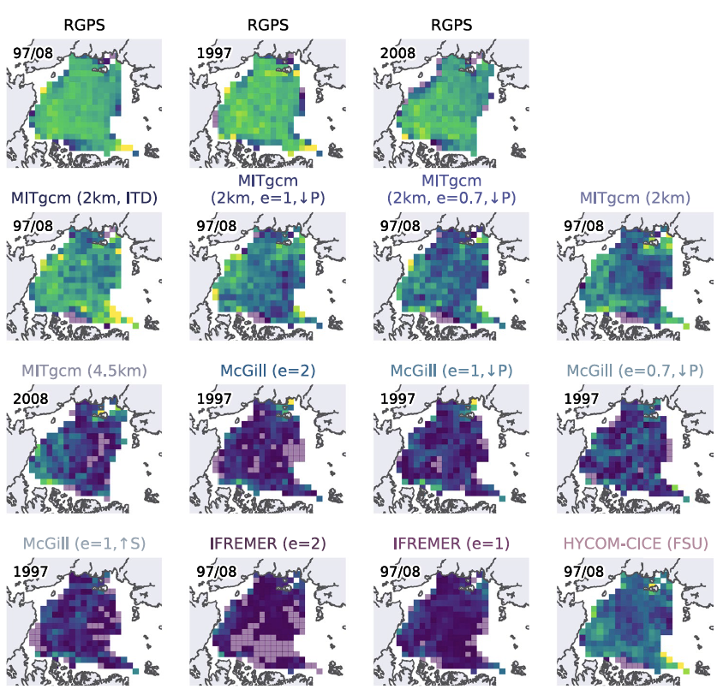
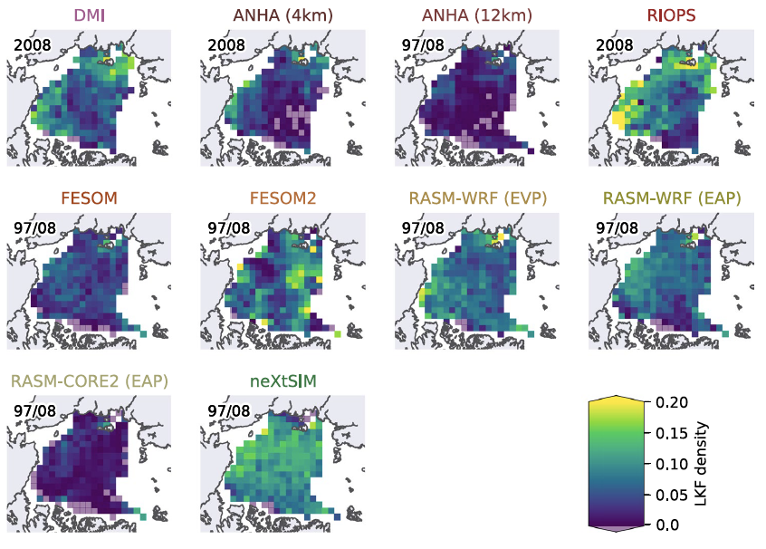
Linear kinematic feature (LKF) densities for RGPS and all models defined as the relative frequency of LKFs within 150 × 150 km boxes in a polar stereographic projection normalized by the number of deformation observations available for the box.
The distribution of LKFs in the SIREx simulations have stronger regional variations than RGPS.

Slide 6
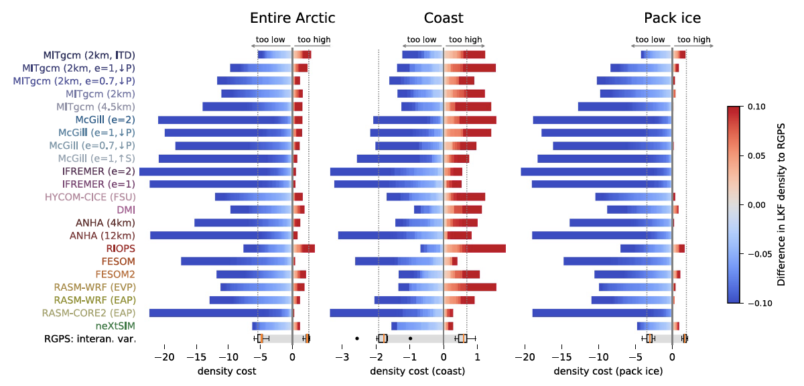
Both models use mechanisms to locally reduce the ice strength based on the deformation history, which initiates fractures in pack ice.
Nearly all models strongly underestimate LKF densities by far more than the range of interannual variability of RGPS.
The largest differences are mainly in the pack ice area.
Cumulative box-wise differences of LKF density for all simulations compared to RGPS. In the bottom row, we illustrate how the RGPS LKF densities of the other RGPS years differ from the two Sea Ice Rheology Experiment winters. The dotted gray lines show the first quartile of the underestimation and the third quartile of the overestimation of LKF densities in all RGPS years as a reference range.
Notes:
here defined as sea ice regions that are more than 150 km away from the coastline

Slide 7
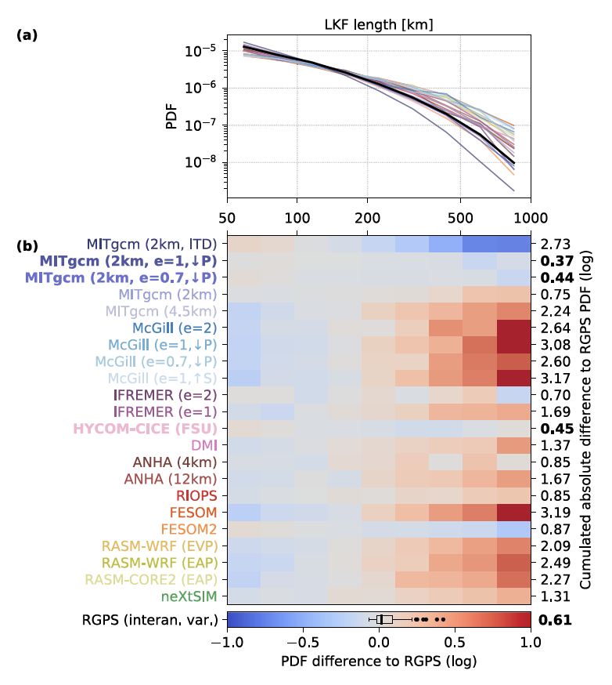
Most models overestimate the number of very long LKFs, especially for models with fewer LKFs.
If more LKFs cover the same area, it is more likely that the intersection with other LKFs makes them shorter (Hutter & Losch, 2020).
(a) PDFs of LKF lengths for all models and RGPS. The difference between the PDFs of simulated LKF lengths and RGPS LKF lengths is shown in (b).
A scalar metric for LKF length is the integrated area between the LKF length PDF of the model and RGPS. As reference, we compute the differences between the LKF length PDFs of all RGPS years and the two Sea Ice Rheology Experiment years to quantify the interannual variability.
Notes:
概率密度函数在总量不一样时能直接比吗？

Slide 8
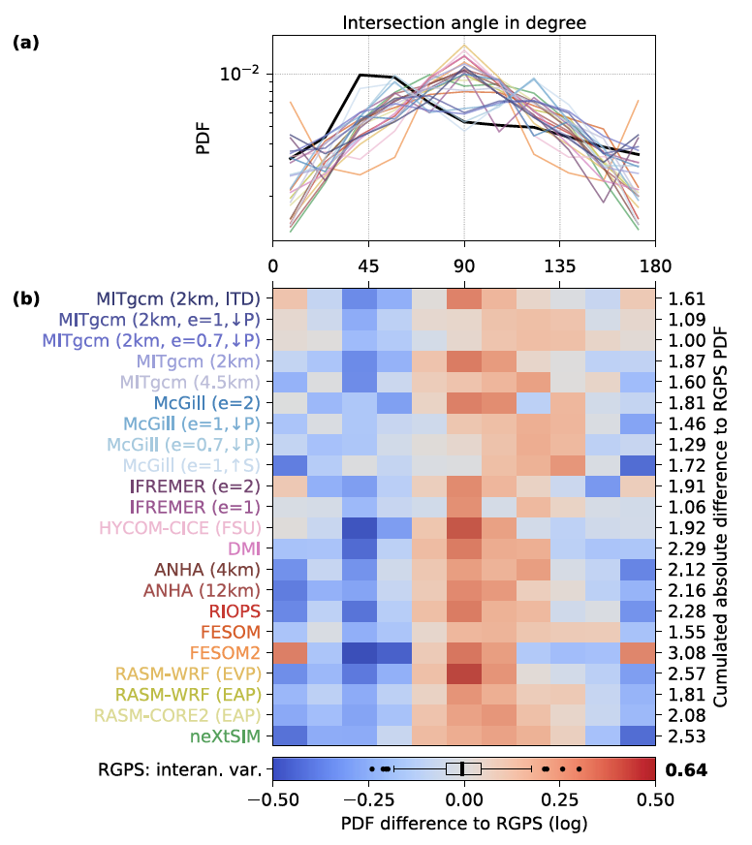
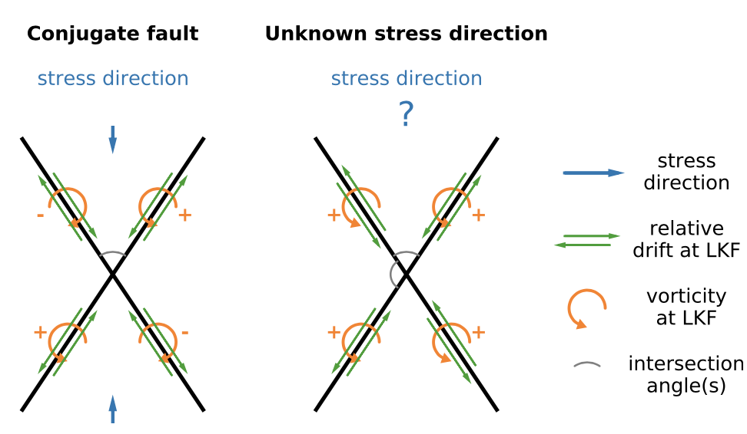
Acute intersection angles ranging around 30°–50°.
The yield curve settings allow a wider range of intersection angles.
Connection between wind forcing and simulated intersection angles does not appear realistic and points to incorrect model physics.
A scalar metric for intersection angles is defined as the integrated area between the intersection angle PDF of the model and RGPS.
Notes:
不知道角的2/3部分以0.5加权全部放进去
We do not mask the LKFs with the RGPS coverage, because some models with very few LKFs do not show intersecting LKFs within the region covered by RGPS.

Slide 9
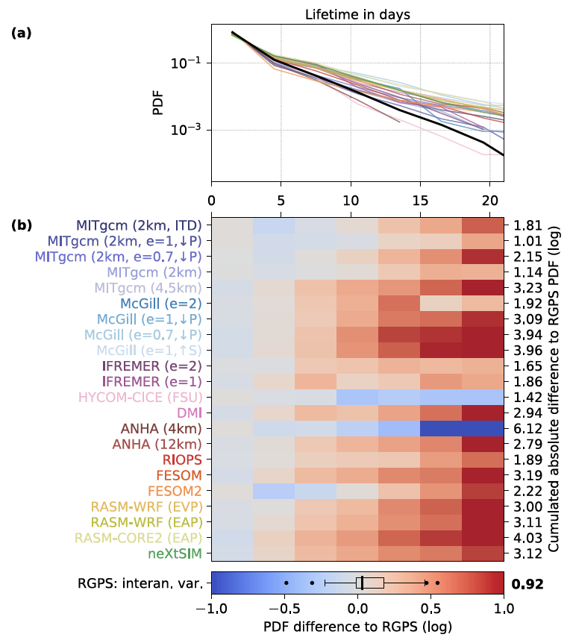
All SIREx models agree with RGPS in the sense that LKFs younger than 3 days are most abundant.
Most models overestimate the relative frequency of long-lived LKFs and produce a too slow decay rate of the exponential tail. LKF lifetimes are likely to be overestimated in simulations that show too many coastal LKFs compared to LKFs in the pack ice area.
Overestimation may have its root in the deformation ice-strength feedback initiating LKF growth in nonbrittle models. The memory of past deformation associated with this feedback may be too strong.
The scalar metric for lifetime is defined as the integrated area between the lifetime PDF of each model to RGPS normalized by the interannual variability in the RGPS data set.

Slide 10
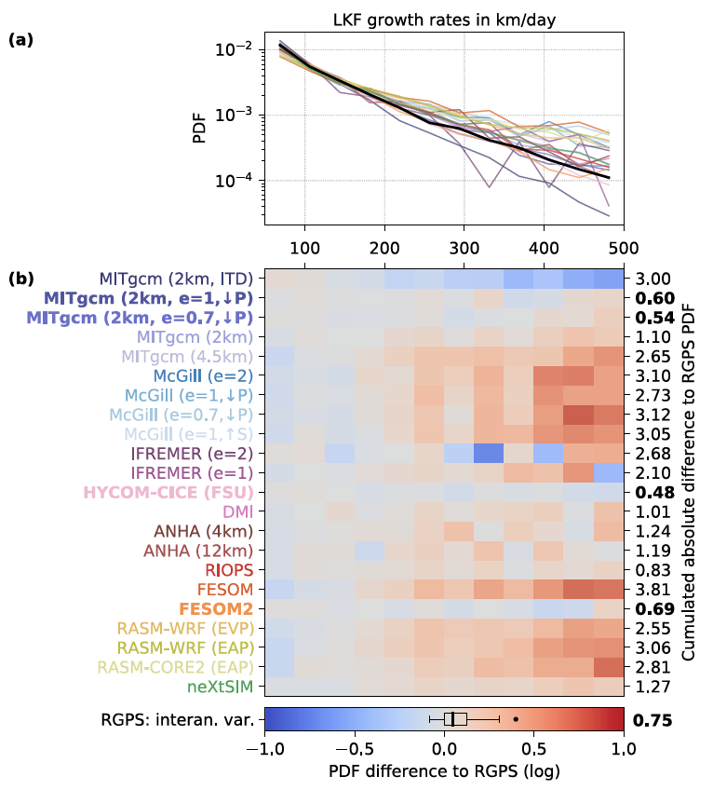
LKF growth rate: the change in length of an LKF between two records.
The majority of the models overestimate large growth events, most of these models also produce too few LKFs.
The growth rates computed for our 3-daily data are limited by the length of the LKFs. A temporal sampling rate of seconds to minutes would be required.
The scalar metric for growth rates is defined as the integrated area between the growth rates of each model to RGPS.
Notes:
7

Slide 11
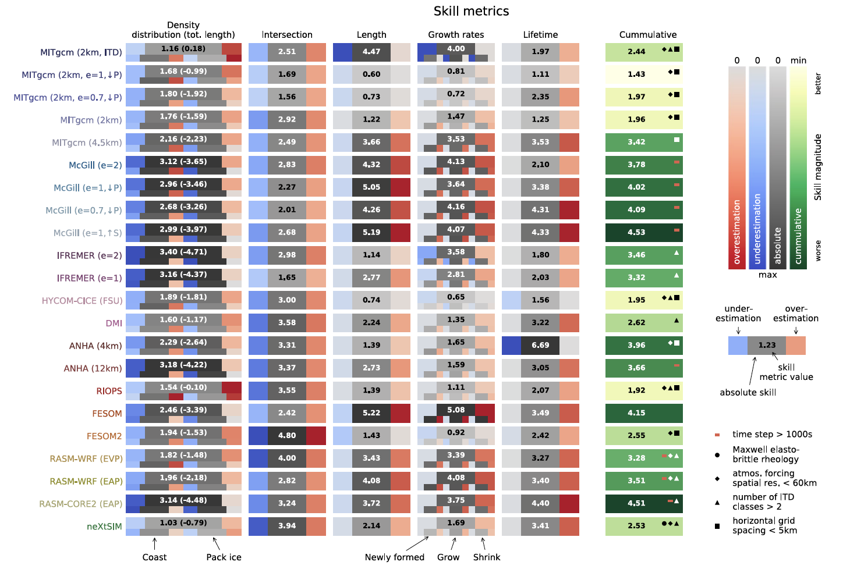
All model values are normalized with the interannual variability for the given property in the RGPS data set.
For density, two skill metric values are computed: The sum of over- and underestimation as a measure for the entire distribution of LKFs and the difference between both as a measure for the overall area covered by LKFs.
Density ⬄ Length
Length ⬄ Lifetime
Length ⬄ Growth rates
Notes:
The last column provides the weighted sum of all skill metrics for each model. To put more emphasis on properties that are mostly relevant to air-ice-ocean interaction processes along LKFs, we take both density metrics (distribution and total length) into account and scale the lifetime metric by a factor of 2. All other skill metrics are weighted with a factor of 1.

Slide 12
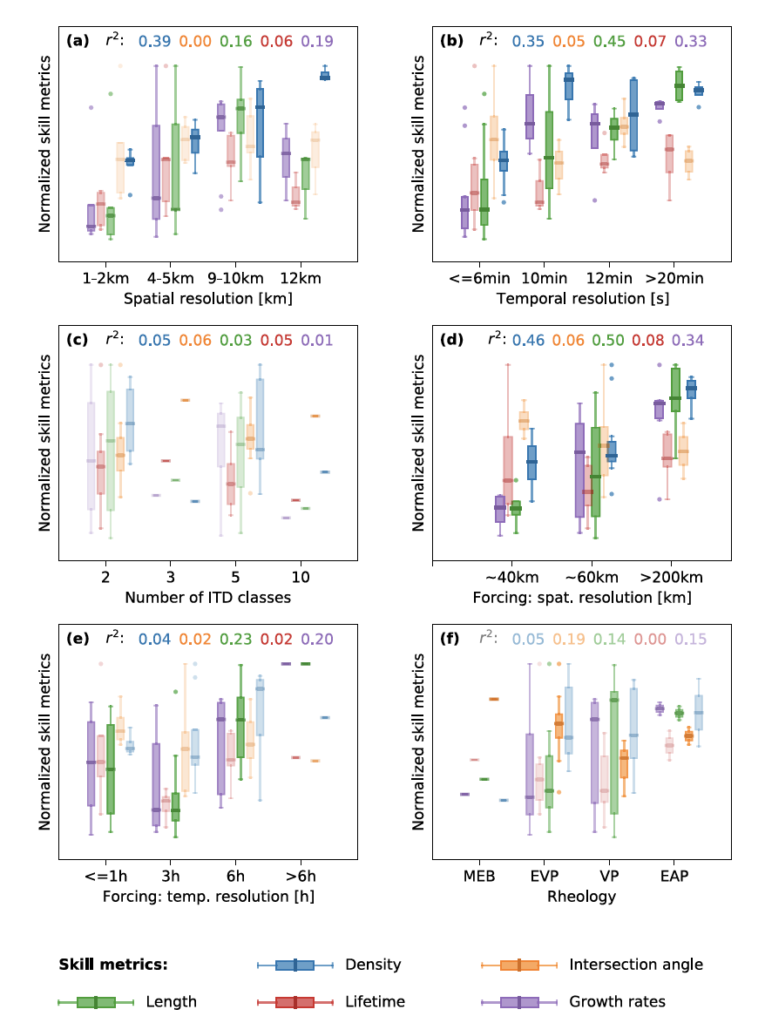
The intersection angle metric may be misleading.
Time step of the simulation and spatial resolution of the atmospheric boundary condition have the strongest effect on the skill metrics, mainly their density, length, and growth rates.
Lifetimes are not significantly affected by the choice of any of considered configuration parameters.
Three of the five models with the lowest cumulative skill metric value (<2) in our comparison use a reduced ellipse ratio (MITgcm (2 km, e = 1, ↓P), MITgcm (2 km, e = 0.7, ↓P), and RIOPS (e = 1.5)).
For each combination of skill metric and model parameter, a linear regression analysis is performed. The box plots saturated colors represents skill model-parameter combinations with r2 > 0.25.
Notes:
7

Slide 13
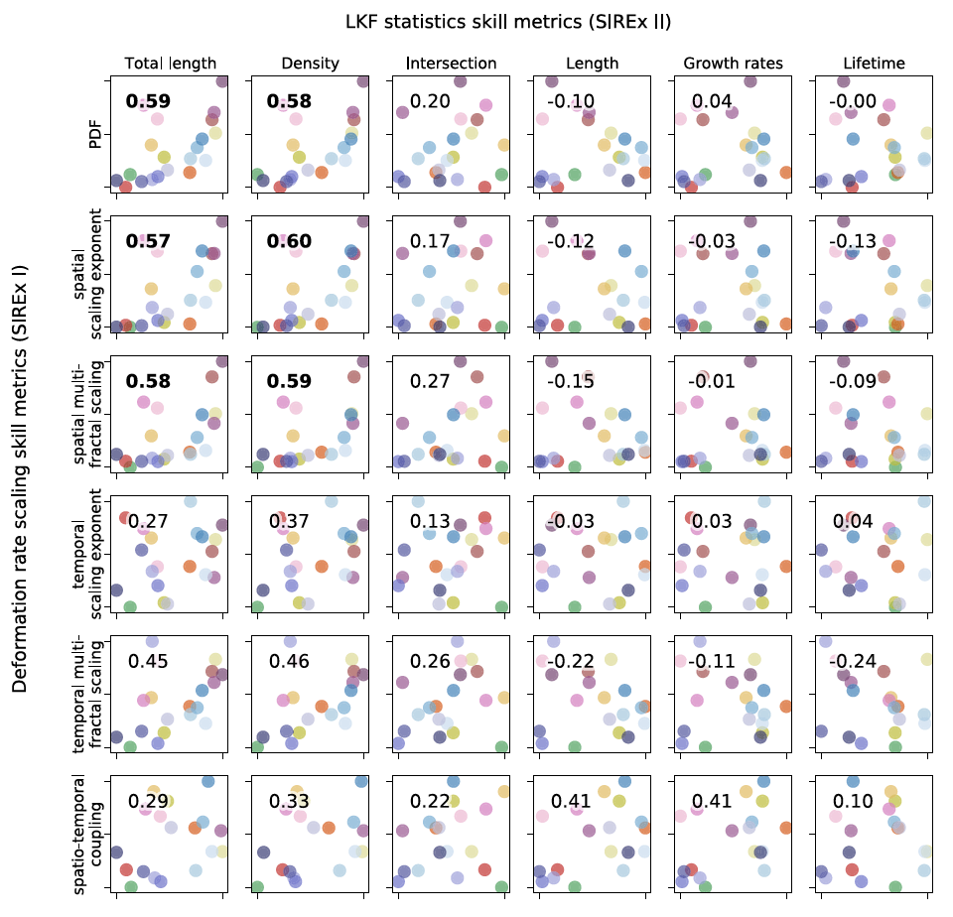
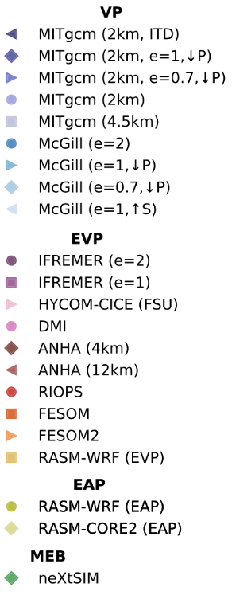
Relationship between skill metrics of the scaling analysis of deformation rates and the skill metrics of the Linear kinematic feature statistics. All skill metrics are normalized.
For each combination of skill metrics a scatter plot is shown, where the correlation coefficient between both skill metrics is given in upper right in each subplot.
Good agreement of a simulation with observations in terms of the temporal (multi-fractal) scaling analysis does not guarantee realistic LKFs in the simulation.
The link between the PDF of deformation rates and LKF density allows to use the PDF of deformation rates as an easy-to-compute metric to quickly assess a sea ice simulation.
Notes:
7

Slide 14
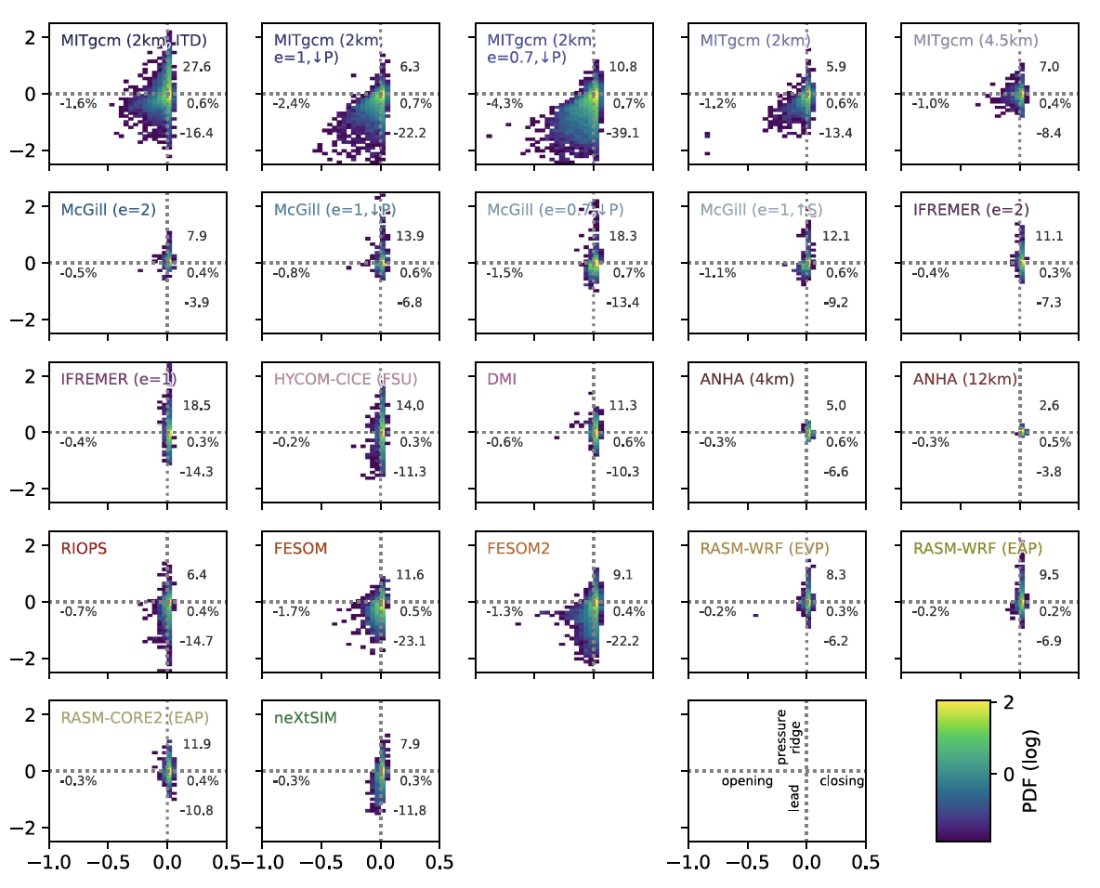
Concentration and thickness anomalies along LKFs for all models given in two dimensional PDFs. The anomaly is defined as the difference of average concentration and thickness along an LKF and the local mean of these fields that is determined by an average weighted by a Gaussian kernel of 150 km. The numbers summarize the mean concentration anomalies for opening and closing as well as the mean thickness anomalies for pressure ridges and leads given in centimeters.
A typical lead shows both reduced ice thickness and concentration, whereas pressure ridges are characterized by increased ice thickness.
The majority of LKFs shows little to no variation in the concentration and thickness field, because the majority of LKFs represents smaller scale or pure shear deformation.
Thickness anomalies are more pronounced than concentration anomalies.
Notes:
Only LKFs in pack ice area and further than 150 km away from the coast are considered.
Note that, the interpolation of the model output of the simulations on unstructured grids (FESOM, FESOM2, and neXtSIM) to regular grids leads to a slight underestimation of the anomalies for these simulations.

